Slide 1
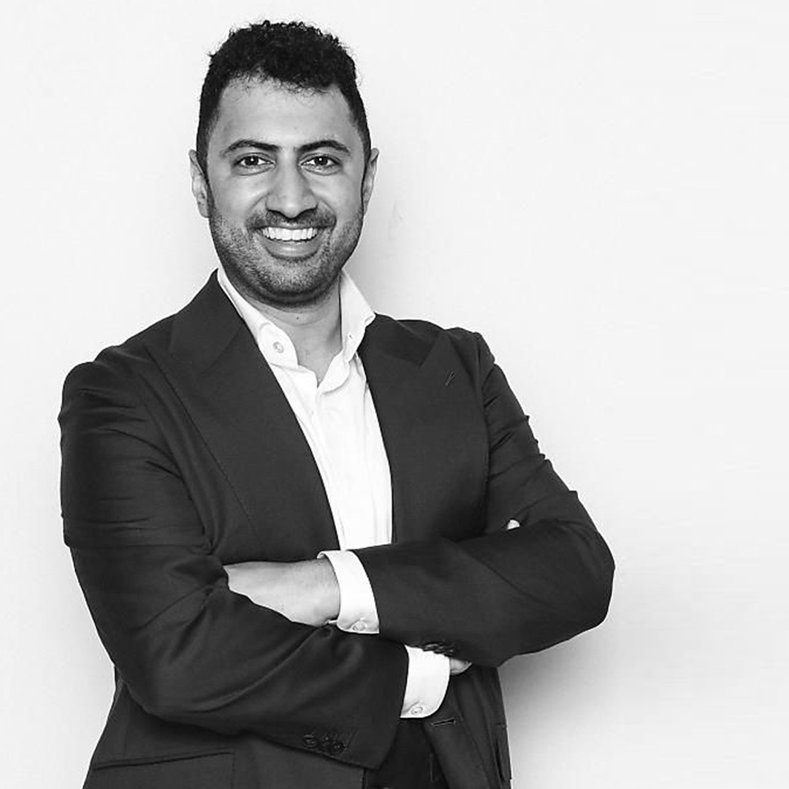
“Early on I
decided HF was
not going to define
me. With the right
support, tools, and
resources I could
live the quality of
life I deserved.”
Marc Bains,
Heart Failure Survivor

Slide 2
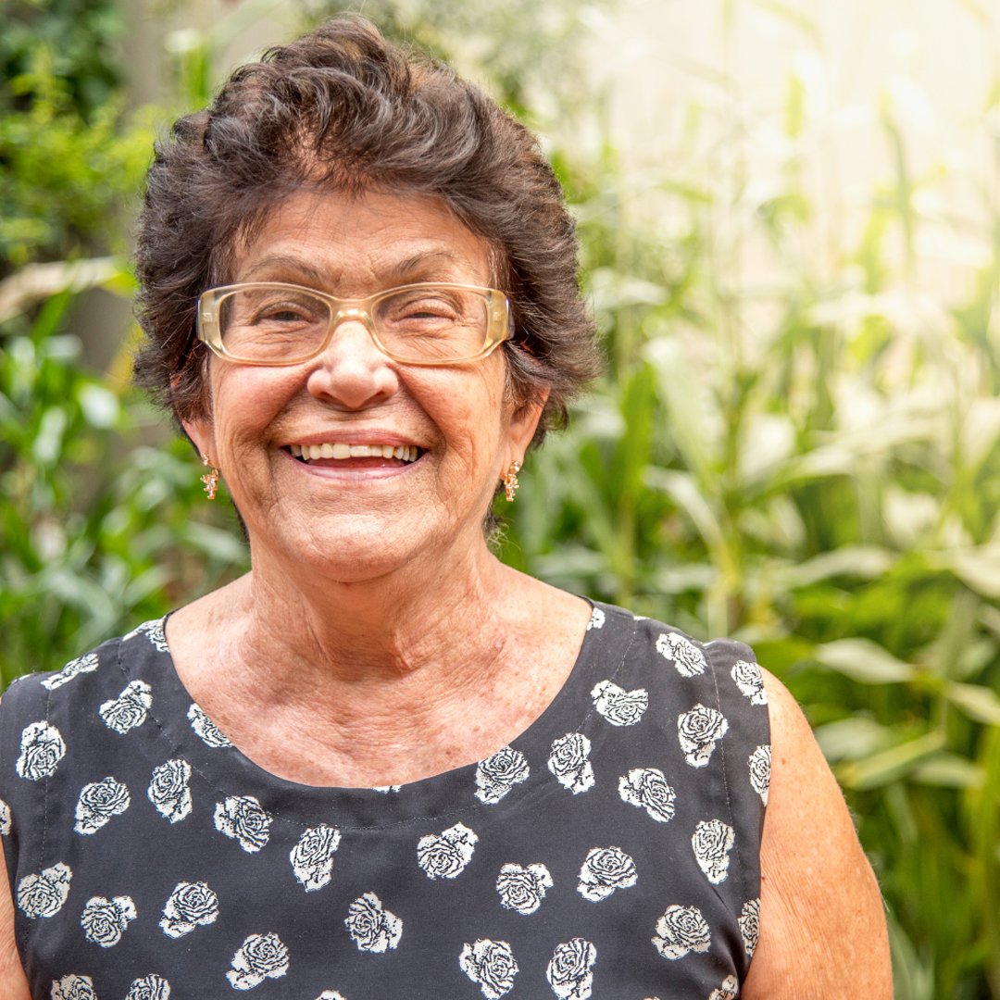
“Having a
supportive
community makes
a huge difference to my Heart Failure Journey.”
Person living
with Heart Failure

Slide 3
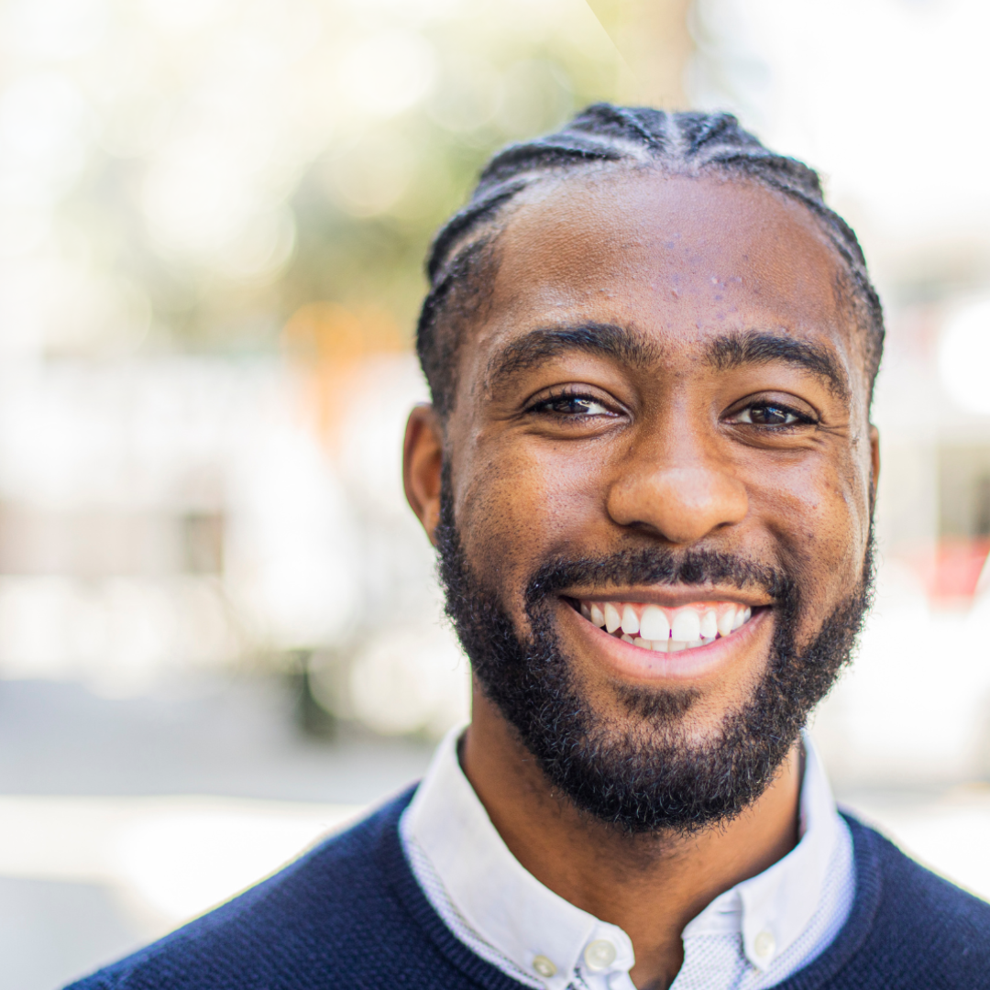
“Heart Failure
doesn’t control me.”
Person living
with Heart Failure

Slide 4
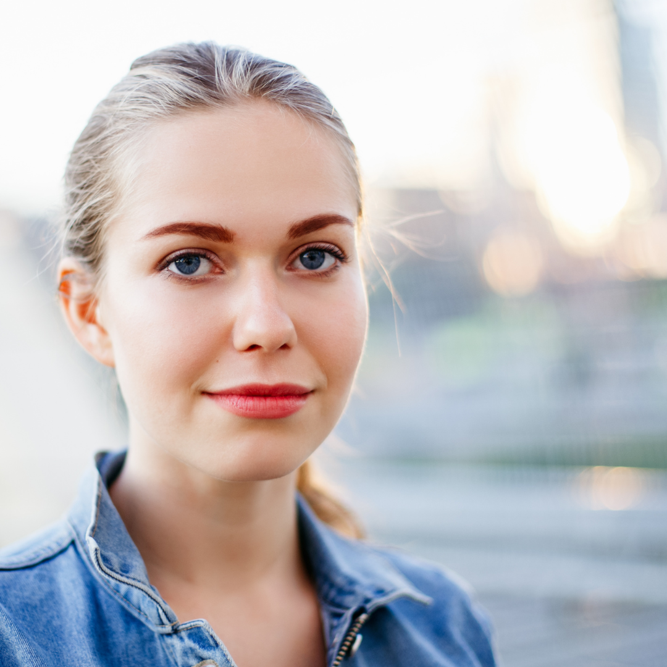
“Every day is an opportunity to be
a Heart Failure
Survivor.”
Person living
with Heart Failure

Slide 5
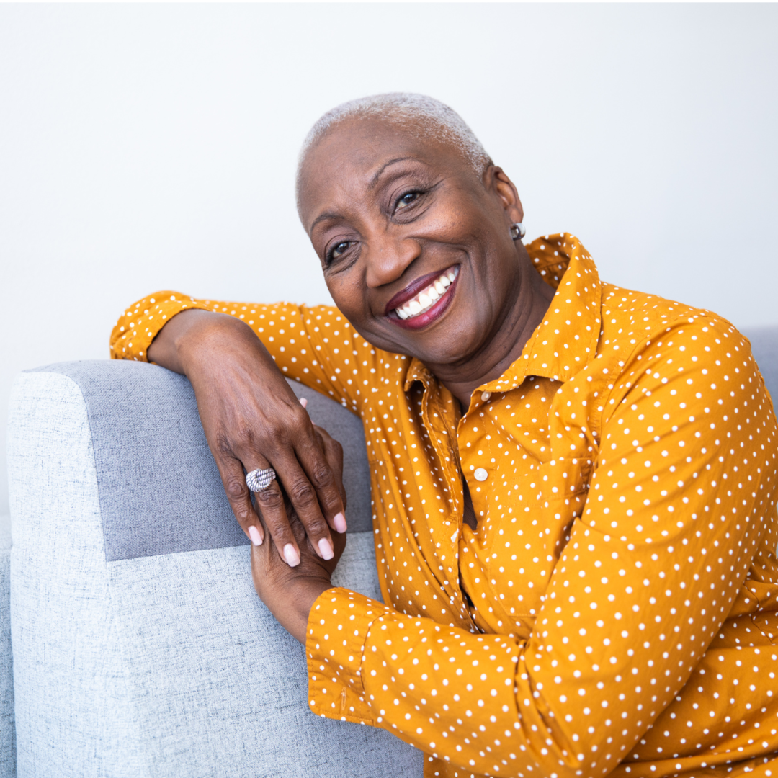
“Heart Failure
won’t stop me.”
Person living with
Heart Failure

Slide 6
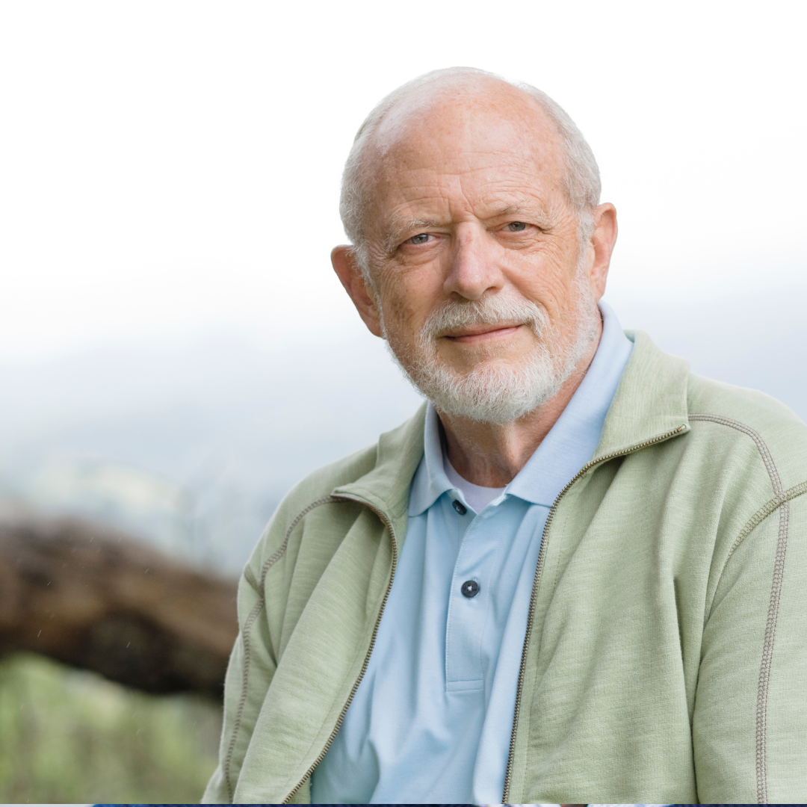
“I am more than my Heart Failure.”
Person living with
Heart Failure

Slide 7
“Heart Failure
won't hold
me back. I am
ready to
live my best life.”
Person living with
Heart Failure

Slide 8
“I won't let
Heart Failure
stop me from
living on my
own terms.”
Person living with
Heart Failure

Slide 9
"When it comes to Heart Failure, no one should have to face it alone."
Person living with
Heart Failure

