Slide 1
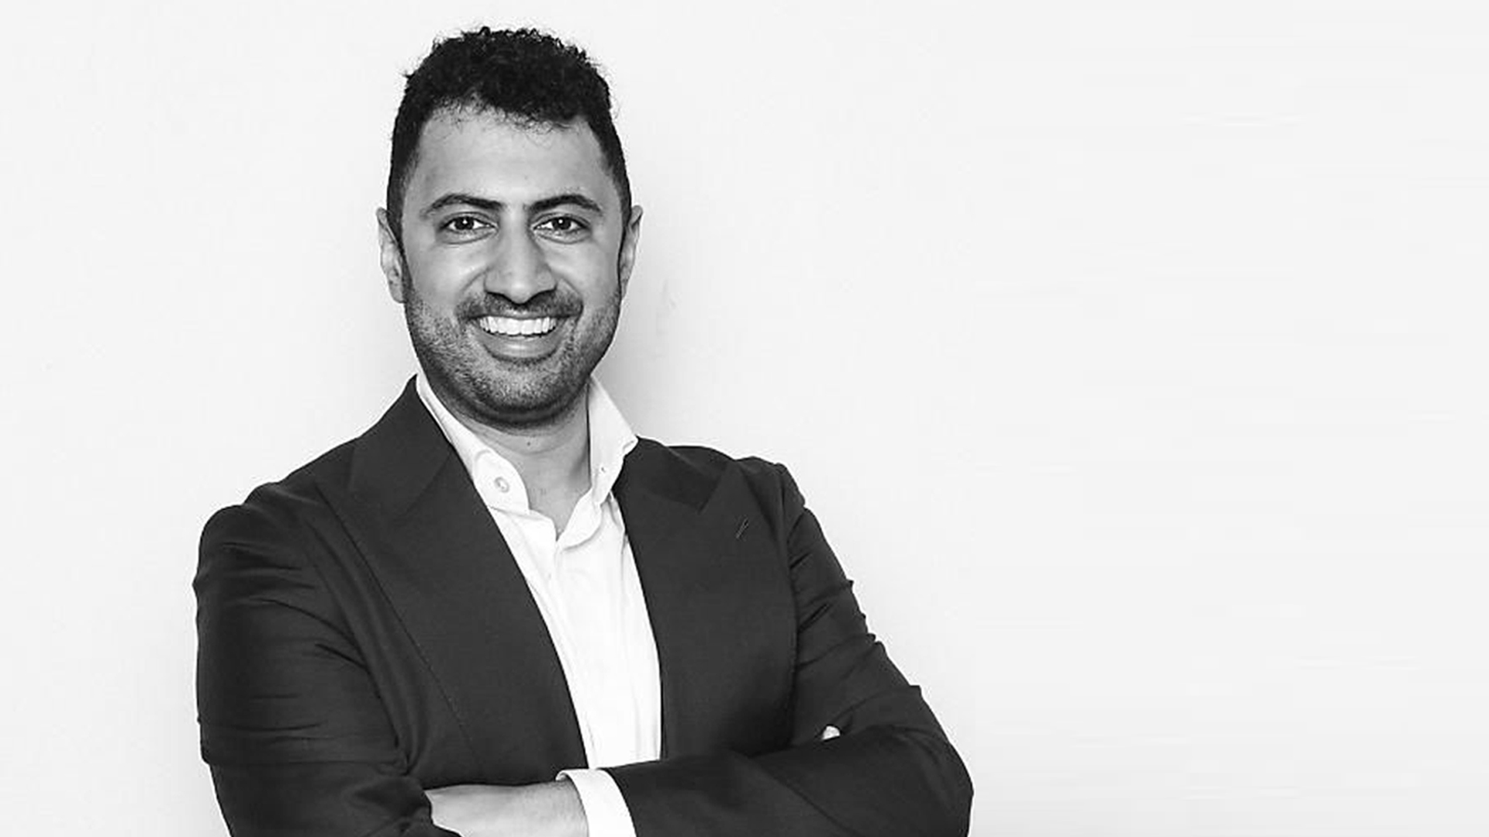
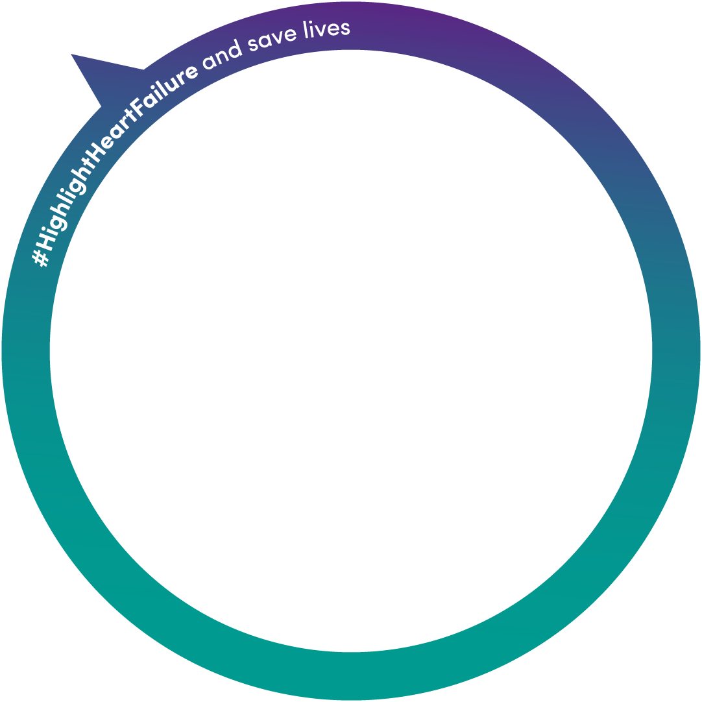
“Early on I decided HF
was not going to define me. With the right support, tools, and resources I could live the quality of life I deserved.”
Marc Bains, Heart Failure Survivor

Slide 2
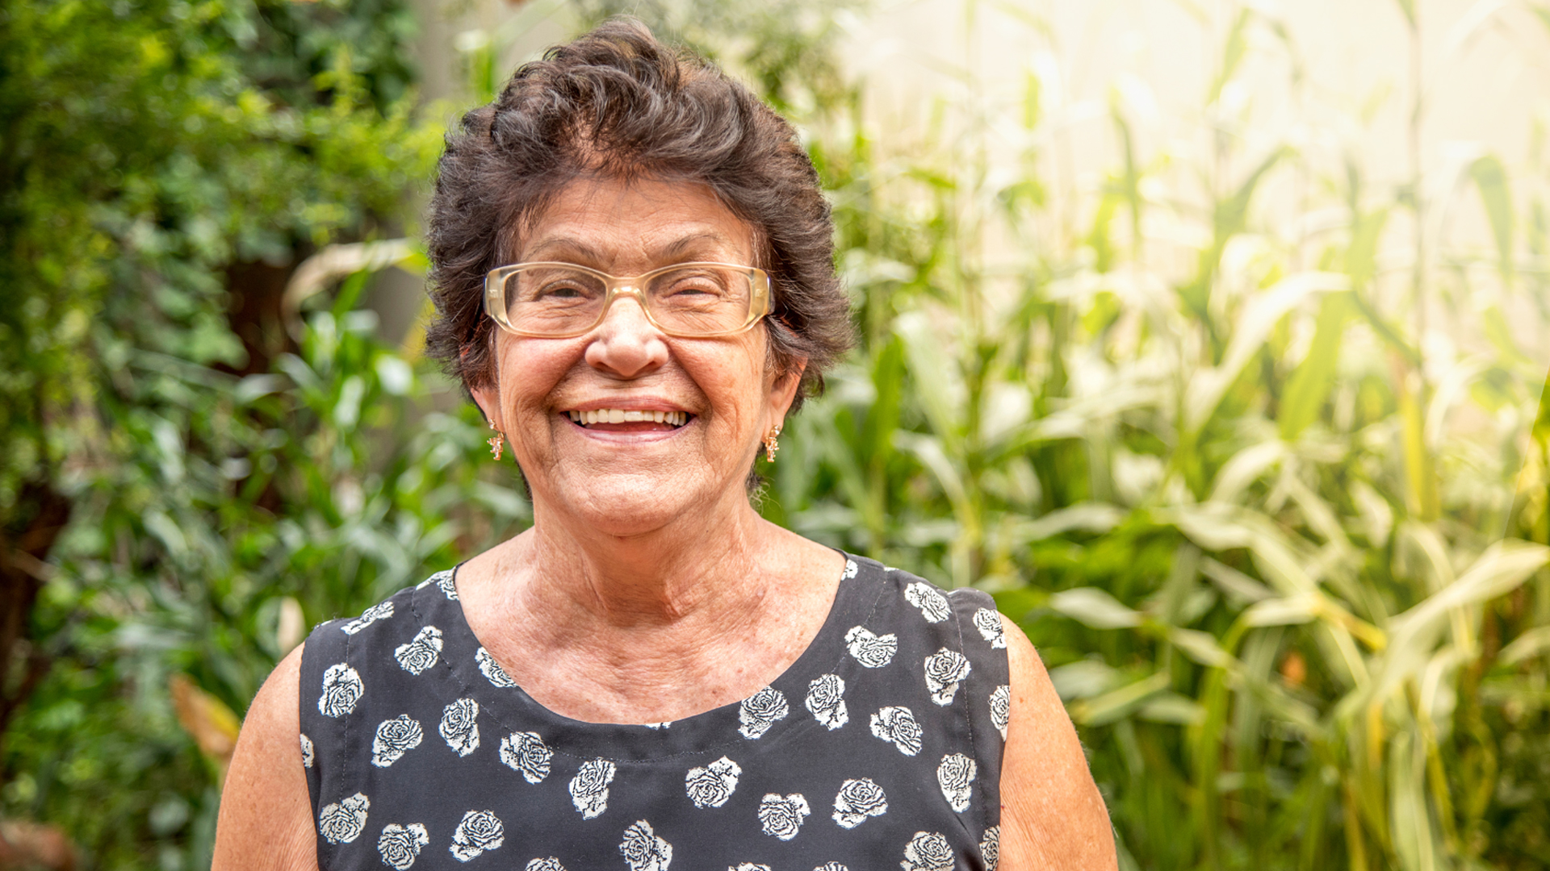
“Having a supportive community makes a huge difference to my
Heart Failure journey.”
Person living with Heart Failure

Slide 3
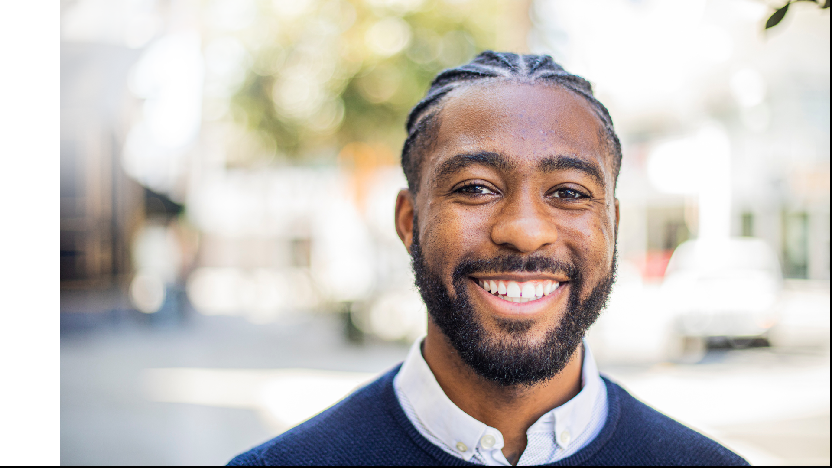
“Heart Failure doesn’t control me.”
Person living with Heart Failure

Slide 4
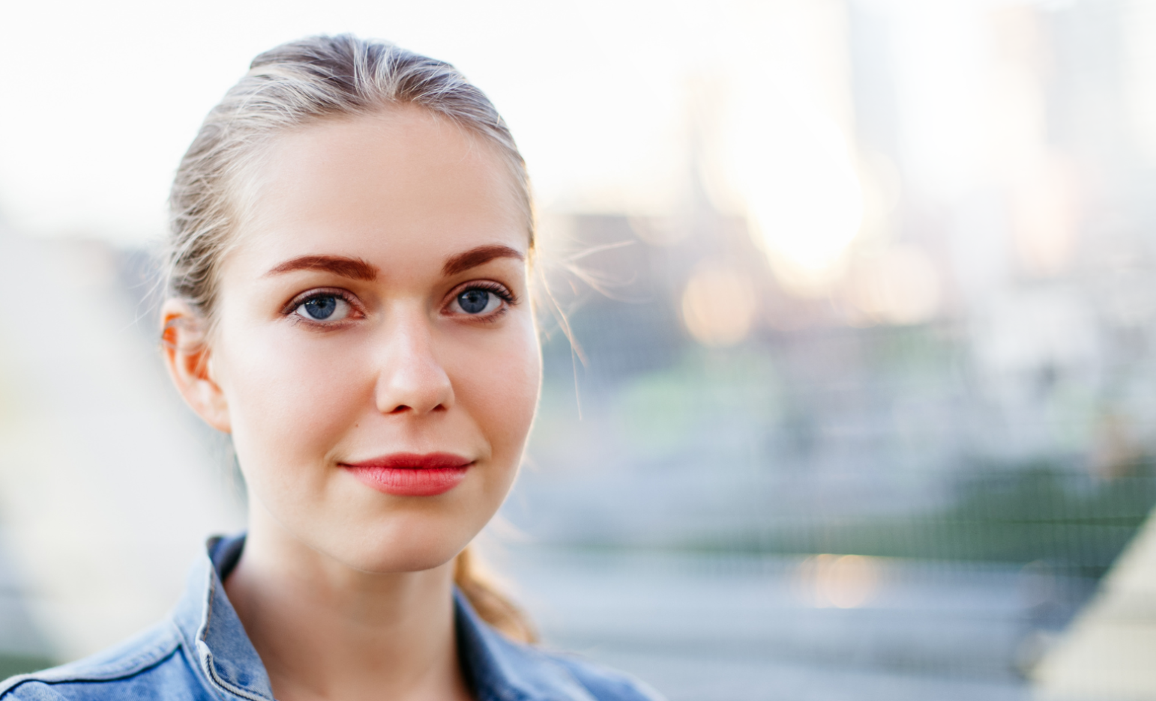
“Every day is an opportunity to be a Heart Failure survivor.”
Person living with Heart Failure

