Slide 1
Some Risk Factors For Heart Failure
Diabetes
History Of
Heart Disease
Iron
Deficiency
High
Blood
Pressure
Smoking
Lack Of Physical Activity
Drugs Or Alcohol Abuse

Slide 2
How Heart Failure Is Diagnosed
Blood Test (BNP)
Echocardiogram
Physical Examination
Chest
X-ray
Electrocardiogram
(ECG)

Slide 3
Estimated 30% Of People Living With
Heart Failure Have No Obvious Symptoms

Slide 4
You Can Improve Your Quality Of Life
Living With Heart Failure
Monitor Your Symptoms
Keep Active
Keep A Healthy Weight And Diet
Limit Alcohol, Quit Smoking
And Avoid
Drugs Of Abuse
Look After Your Mind
Weigh Yourself
Regularly
Take Your Medicines
As Prescribed

Slide 5
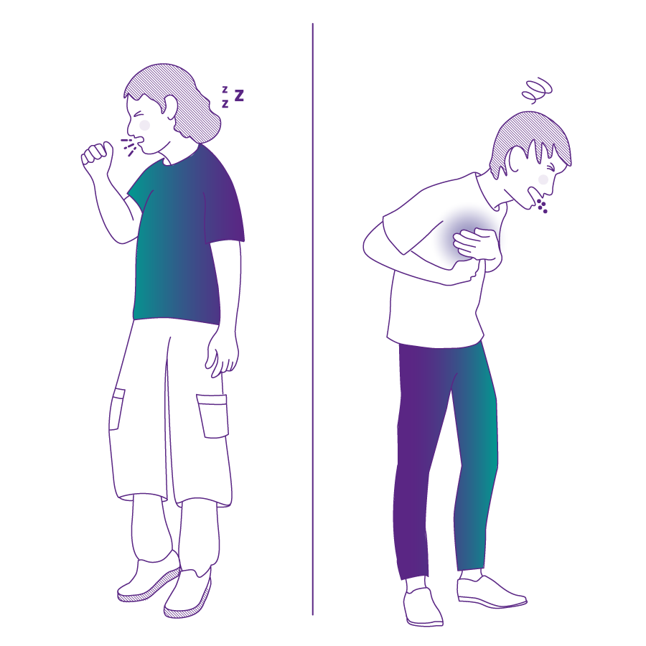
Heart Failure
A PUMPING PROBLEM
Heart Attack
A PLUMBING PROBLEM
≠
Extreme Tiredness
Pain/Discomfort
In Jaw, Neck,
Back, Shoulder
Or Left Arm
Light Headed Or Unusually Tired
Dry Cough
Shortness
Of Breath
Nausea And
Vomiting
Sudden Weight
Gain
Swelling In
Legs, Ankles
Or Feet
Sharp Chest Pain Or Upper-Body
Discomfort

Slide 6
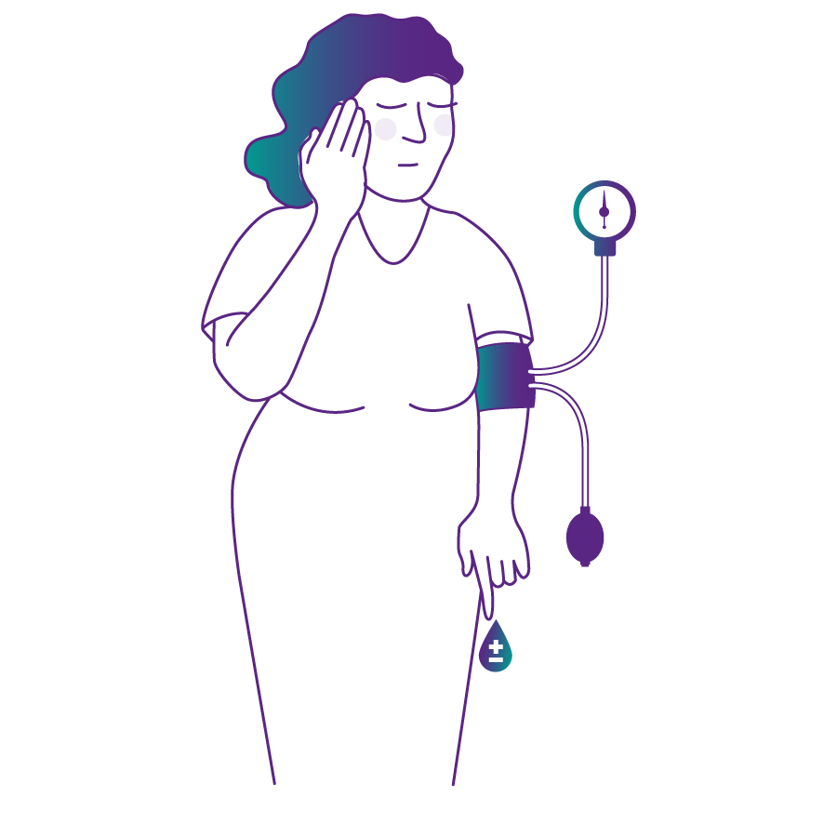
Heart Failure Risk Factors That
Are Higher In Women Than In Men
Hypertension
Emotional Or
Physical Stress
Takotsubo Syndrome
Or Broken Heart
Syndrome
Obesity
Diabetes

